Slide 1

Daily Bonus Feature Design

Slide 2


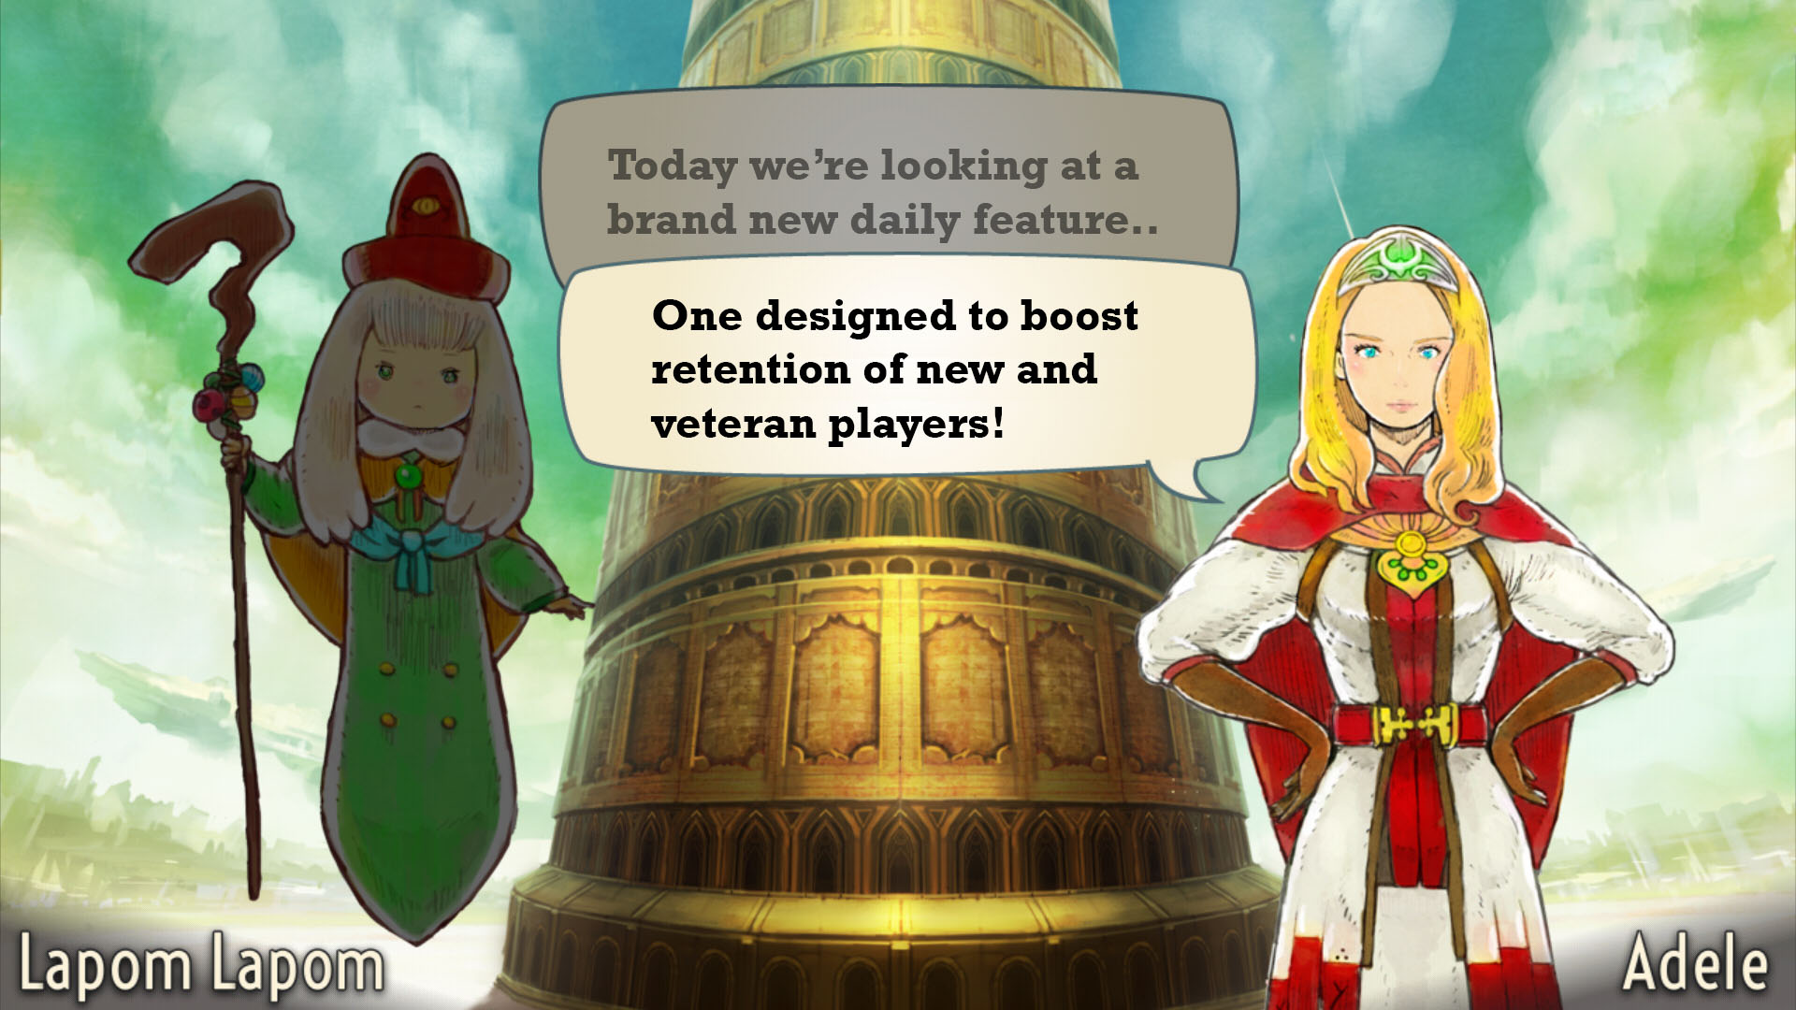
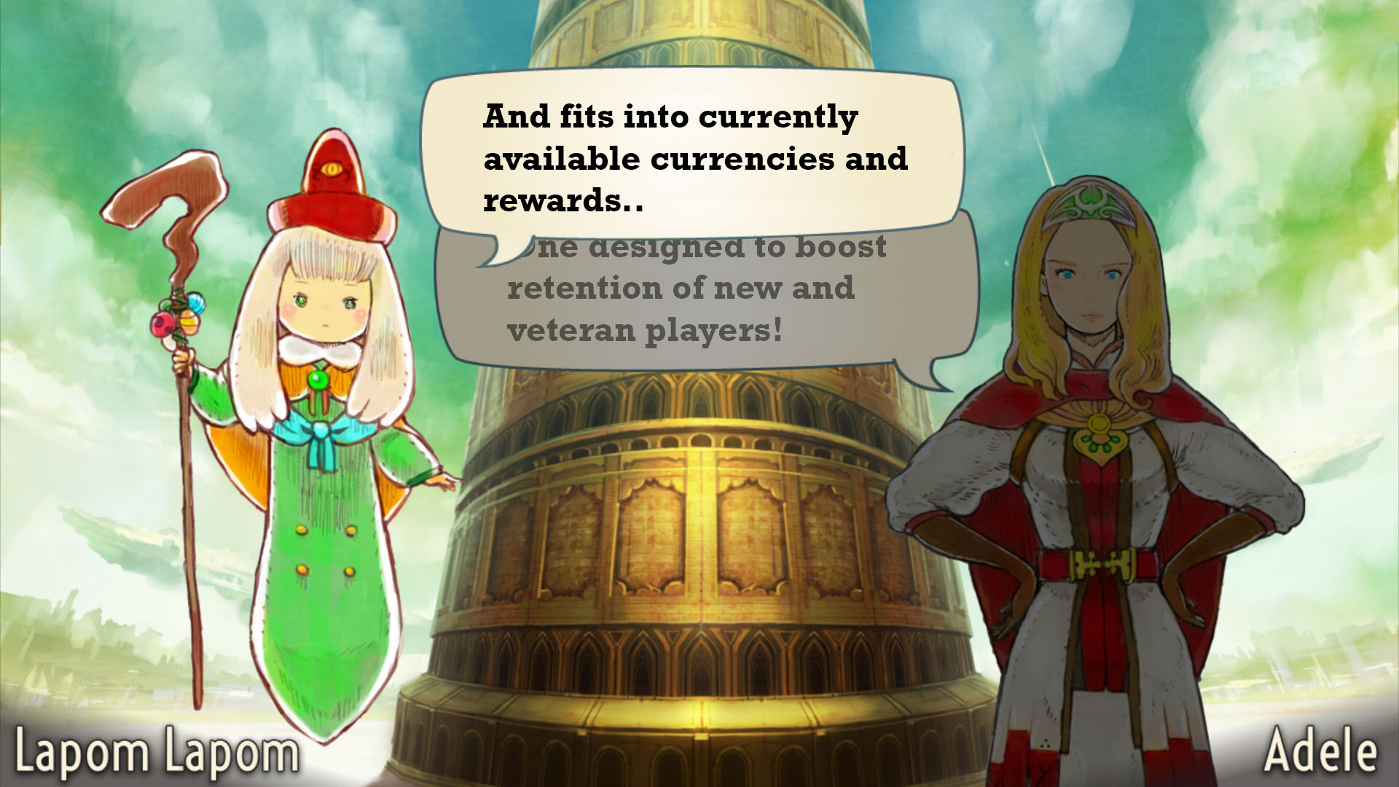
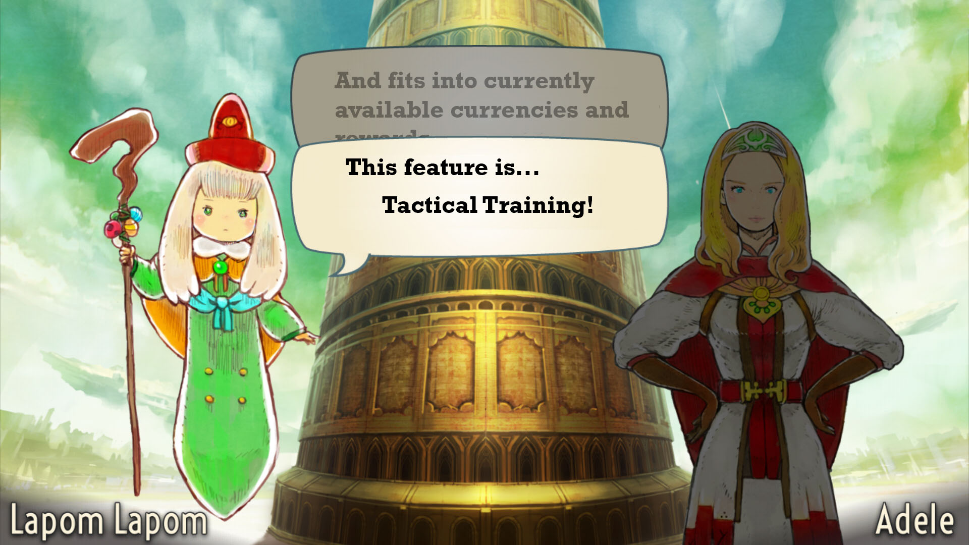
Additional Daily Feature

Slide 3
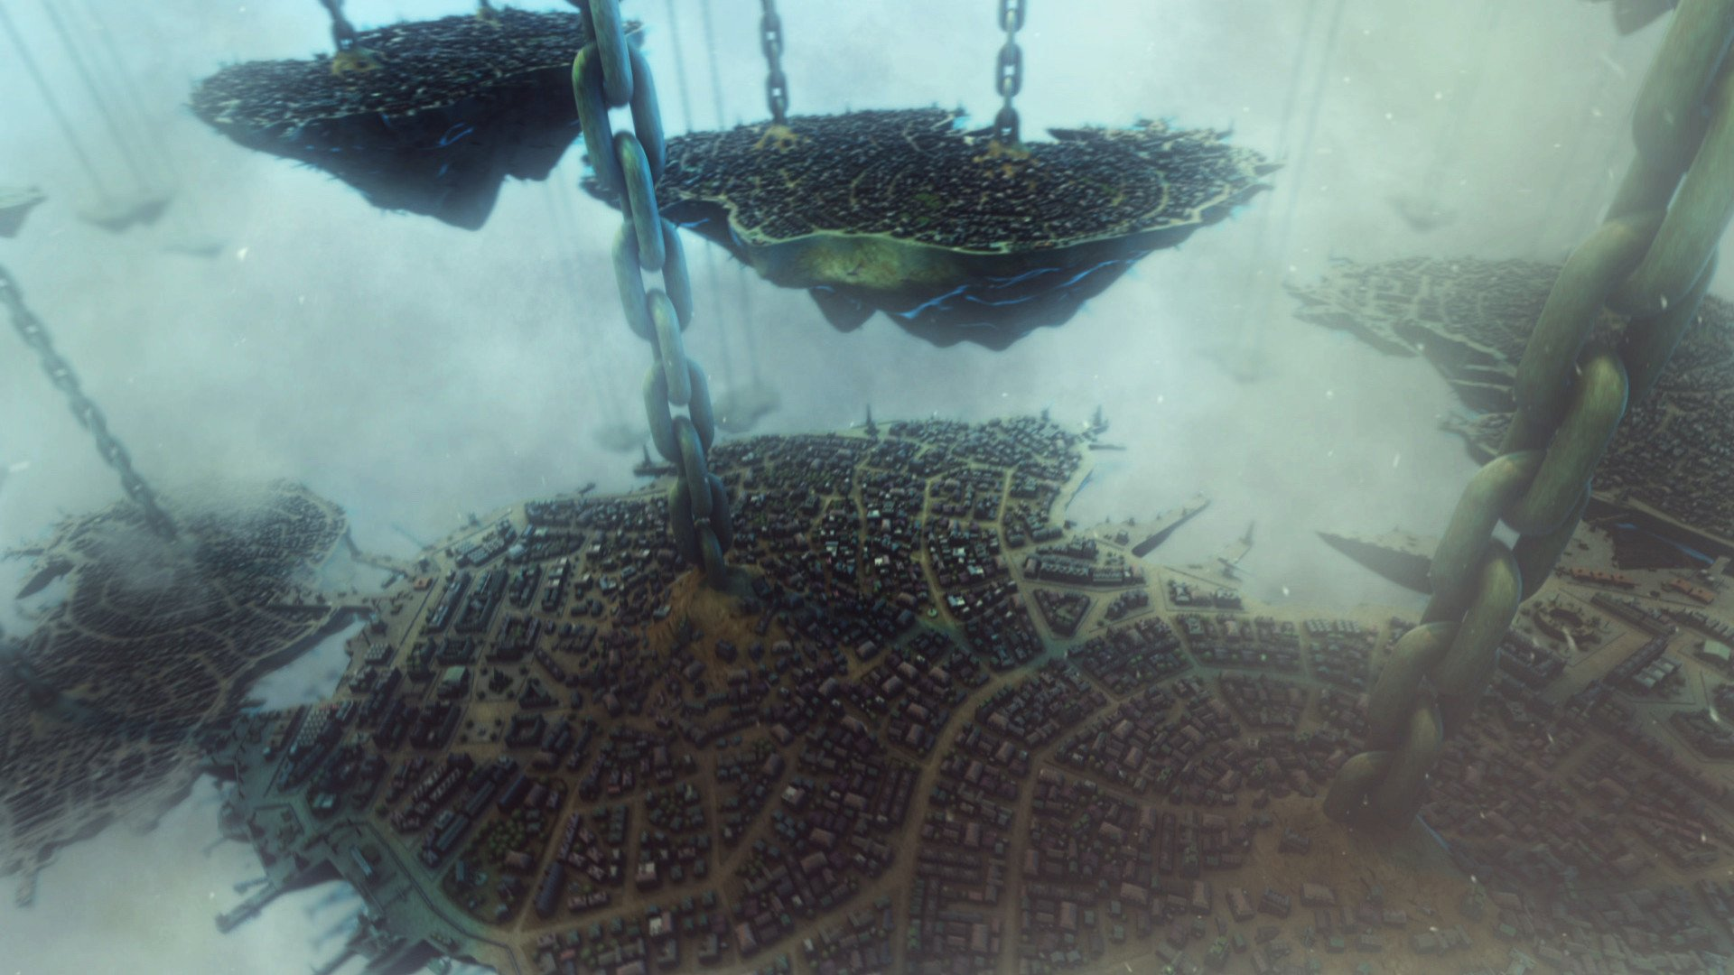
FEATURE OVERVIEW

Slide 4
The Tactical Training Feature is a new PvP mode for the game that players can participate in once per day. Players will be assigned a random selection of units that they can use to make a squad, challenge other players and win rewards.
If a player loses a battle, or wins 5 battles, their participation for the day is over, and they no longer have access to the squad they created.

Slide 5
The purpose of the Tactical Training daily feature is for players to try and build novel and creative squads out of a random set of powerful units, in a self contained environment where there is no penalty for "incorrect" choices.
This system has advantages for new and veteran players alike..

Slide 6
For top level players
- Experimenting with unit synergy
- Challenging their ability to discover potential squad builds
- Using newly discovered squad builds to push the meta in league and arena
- Creates a top level gameplay challenge that exists outside of the meta

Slide 7
For mid level players
- An additional way to earn currency
- An exposure to new units they may then chase
- An exposure to max level/promoted units they may already own,
encouraging investment into levelling
- A taste of competitive squad building of top level play

Slide 8
For newer players
- Able to see and experience a wide variety of units
- Opportunity to learn origin of units they like (e.g. purchaseable/recruitable)
- Able to have a feel for high level units
- Opportunity to try PvP with a sense of "even playing field"

Slide 9
FEATURE FLOW

Slide 10
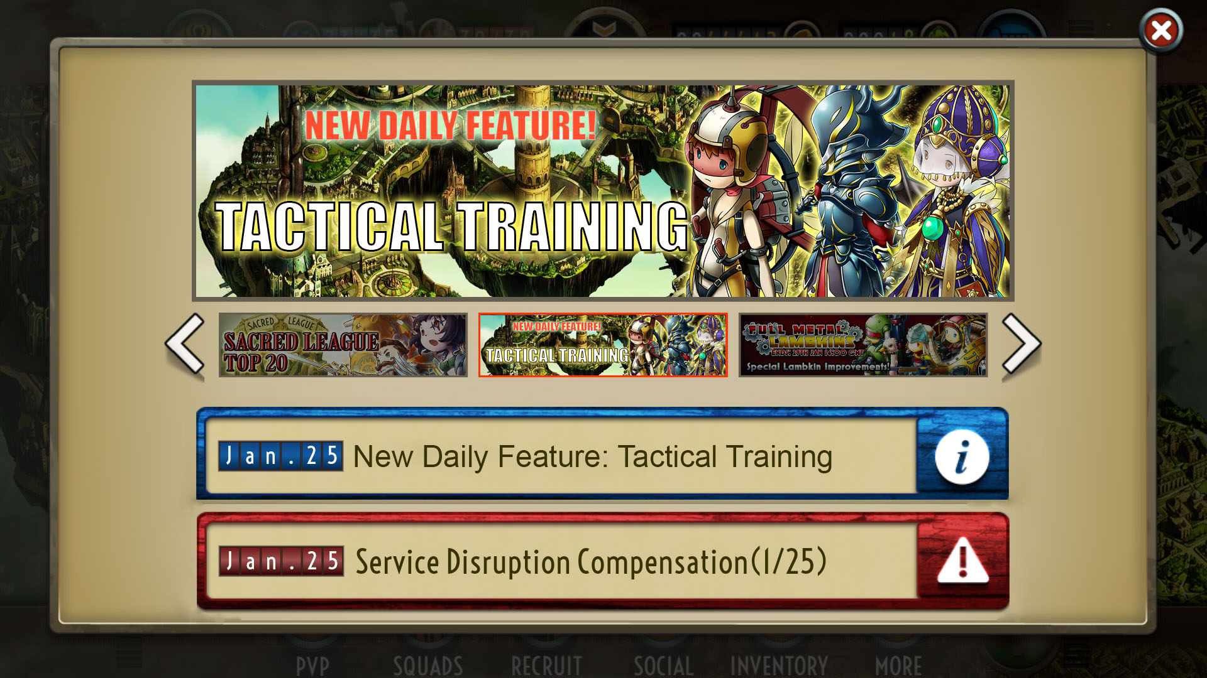
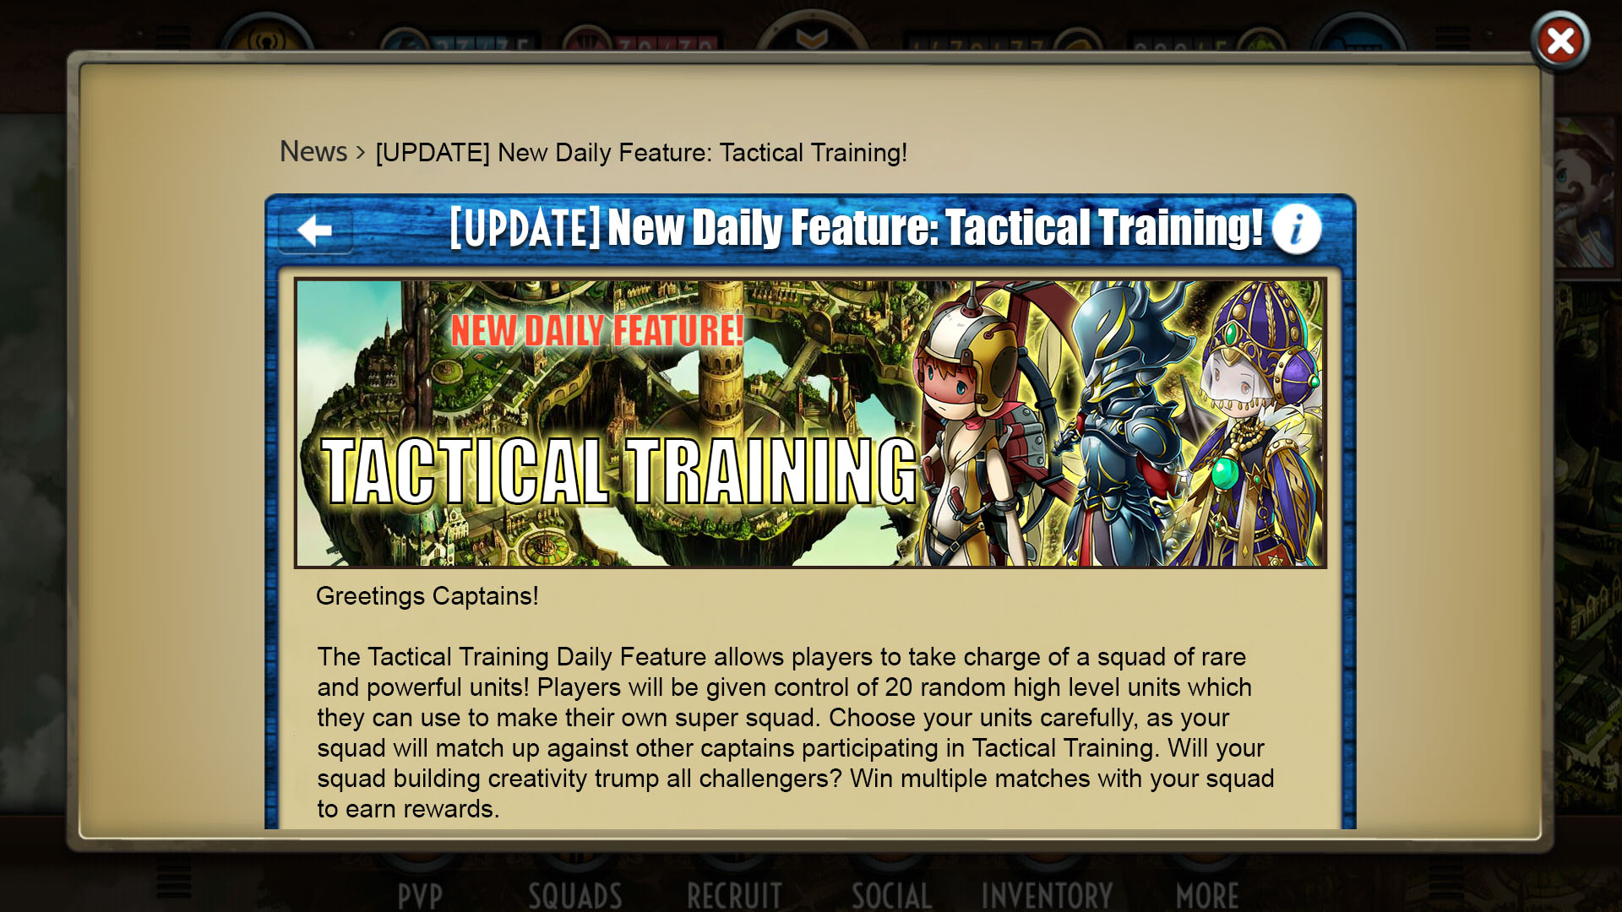

Slide 11
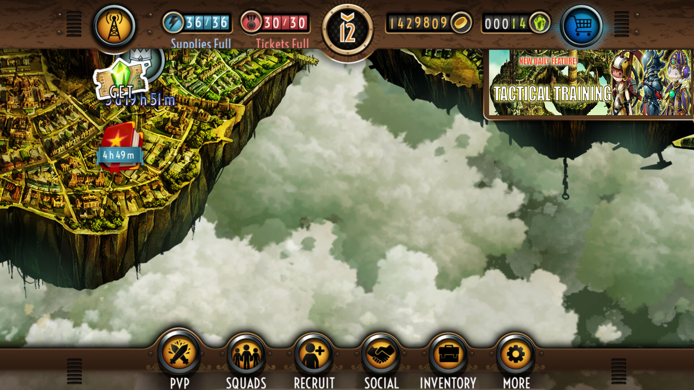
Players will see a prompt for the new feature in the upper right corner in the same manner that other prompts are displayed to the player.
Clicking on the prompt will take the player to the local screen where the feature is located on the map.

Slide 12
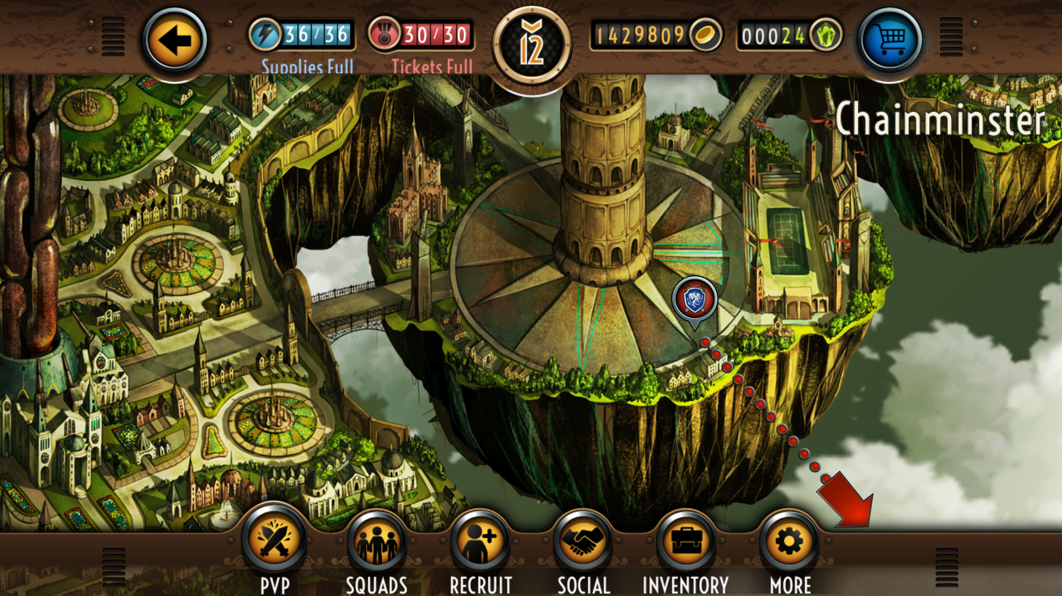

A unique pin icon for the feature will be created.
Players will click on the pin to launch the start screen for the feature. This will provide a brief summary of the feature, as well as cost and potential reward.

Slide 13
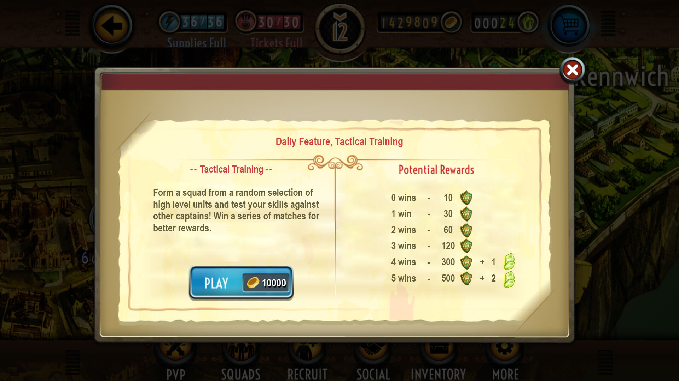

Slide 14
COST
PvP matches and missions cost tokens or charges which are automatically restored over time, or can be refilled by trading cores. A similar system wouldn’t work for a feature that can only be participated in once per day. As such, a flat currency cost seems most viable with coins being a good candidate.
The cost of participation should not be a barrier for entry, even for newer players, but should also be a currency sink over time, given the feature is available daily. Given a weakest exchange of 250000 coins per core, 10000 coins daily cost feels sensible for the Tactical Training feature, keeping it perfectly viable to participate daily while maintaining f2p, but encouraging core purchasing for depleted coins and cores.

Slide 15
REWARD
The reward structure should be comparable but not favourable to league and arena PvP.
Arena rewards players with units, coins and cores, while league offers sacred shields. As coins are the base cost of participation, sacred shields and cores are the best suited reward.
In league PvP, 10 sacred shields are awarded for a loss and 30 for a win, which will set the base reward for this feature. Finishing in the middle bracket of a players league group rewards between 3000-4500 sacred shields. Therefore a weekly maximum of 3500 sacred shields through Tactical Training, with a much lower average is appropriate.

Slide 16
REWARD
In the "new features" forum thread many players request additional ways to earn cores through regular gameplay.
Tactical Training would be a good opportunity for this. Arena offers 1 core for 3 trophies and 2 cores for 8 trophies, and as such I have suggested 1 core for 4 wins and 2 cores for 5 wins. Assuming a 50% chance of winning a match this equates to roughly a 22% chance of gaining 1 core per week and an 11% chance of 2 cores per week from Tactical Training.

Slide 17
REWARD SINK
With an additional source of sacred shields and cores added to the game, it is worth looking at their sinks.
Recruitment is a stable sink for cores, and the small inflation due to the Tactical Training feature should not disturb this. The inflation of sacred shields should also be small, but could however stand to be alleviated by making available additional units for purchase via sacred shields.
A tangential feature, requested by the community, is for captains to be customisable (through e.g. clothing, hats) which if developed could be purchasable for money or sacred shields.

Slide 18
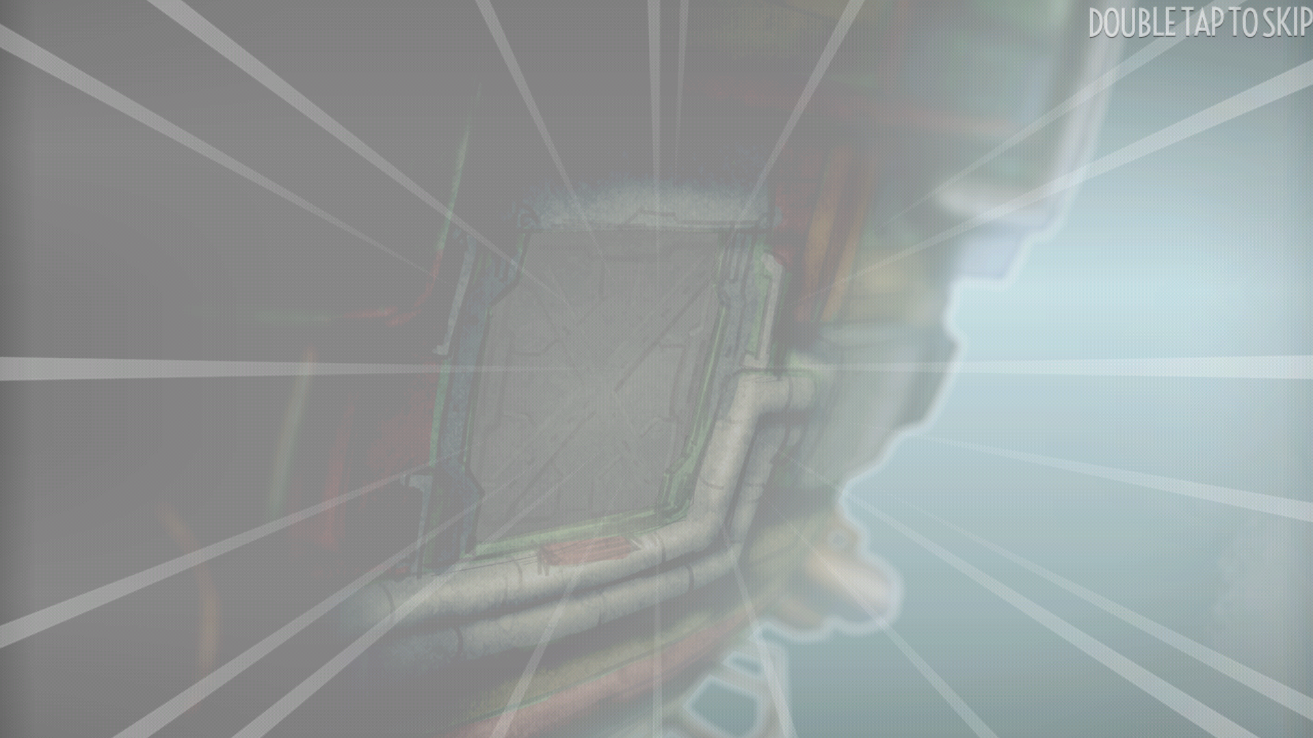

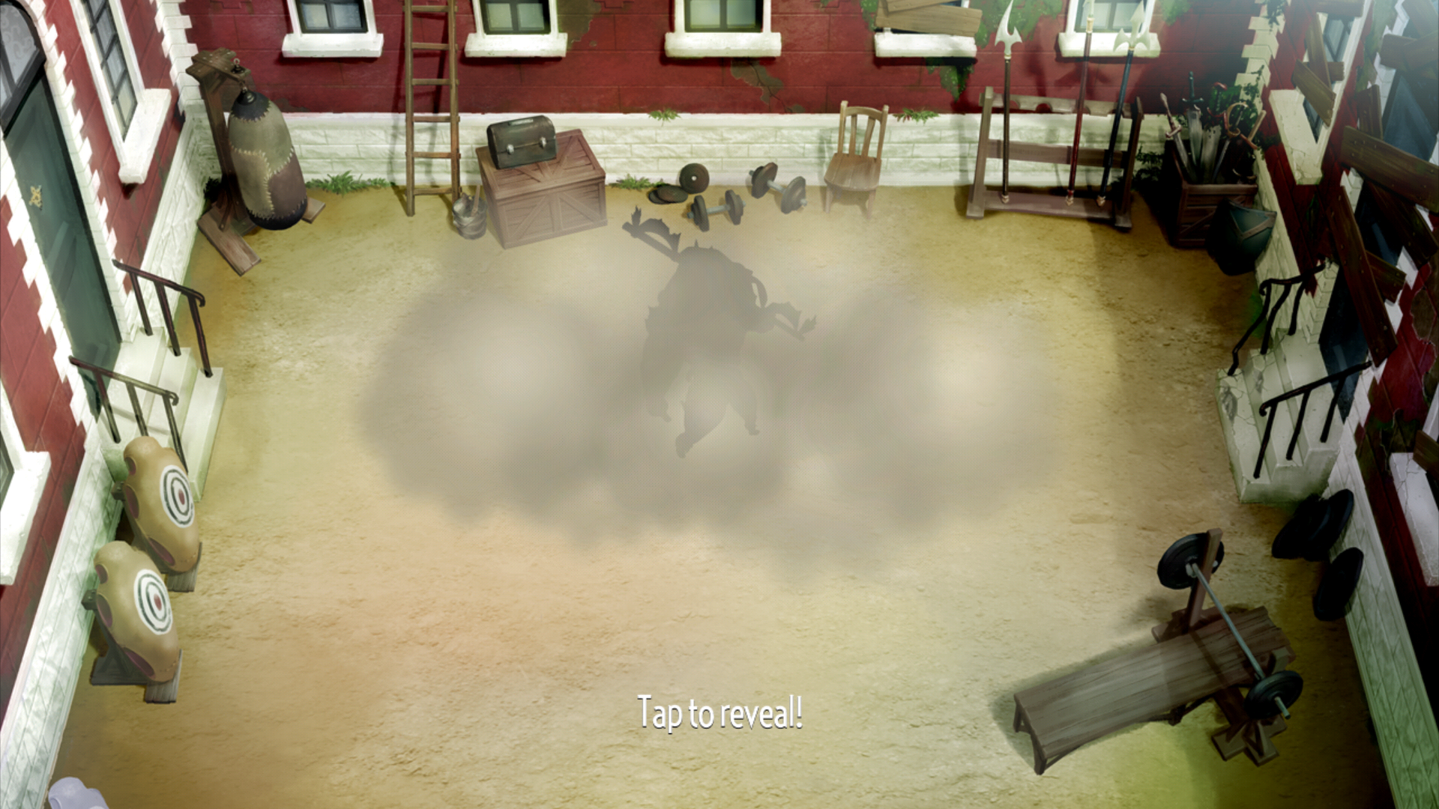
SQUAD SELECTION
Players that participate in the feature will be taken through the recruitment animation, where units are spawned into the courtyard for players to reveal.
Players will be given a random selection of 20 units, from which they will be able to form their squad. The units should be max level, with max level unit skill.
The companion spreadsheet offers a prototype of this system. It will generate a random selection of units from the restricted database that has been constructed, detailing their class, race, unit skill and stats.

Slide 19
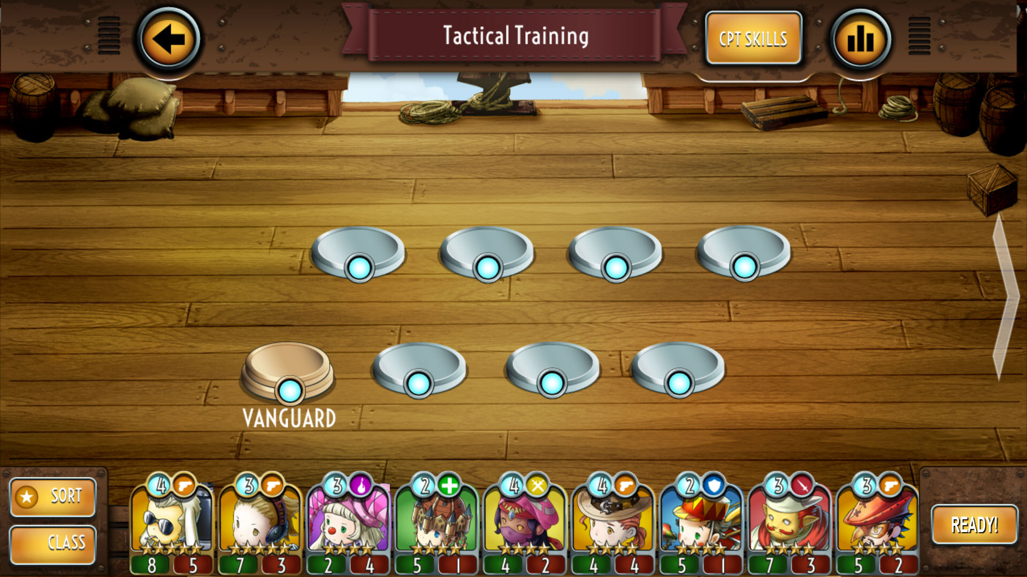
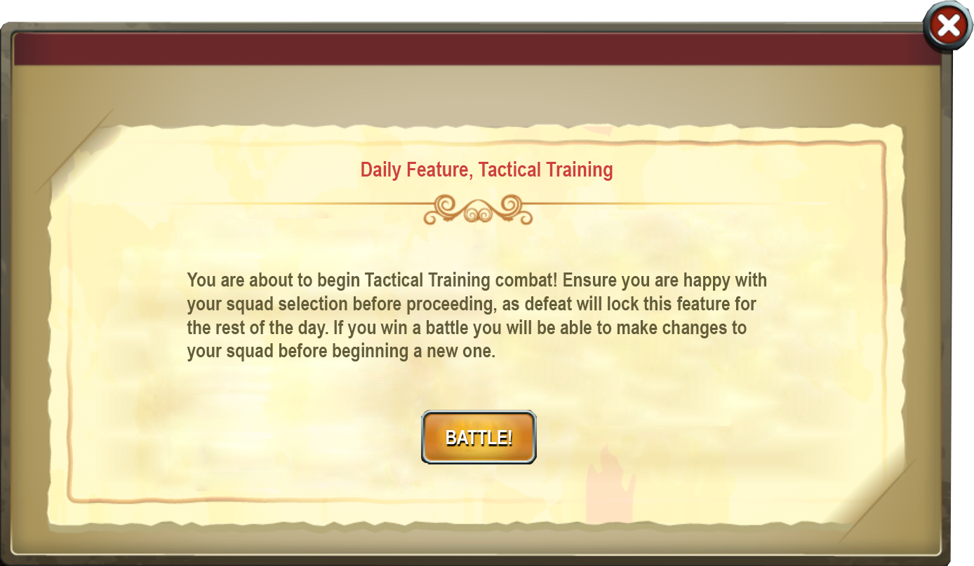
After the random selection of units has been revealed, players are taken to a squad selection screen where they can choose which units will make up their squad.
The recruit banner has been replaced with a new button, “Ready!” Hitting this button will bring up a confirmation window, reminding players that they are about to enter combat, and are able to change their squad after a battle.

Slide 20
MATCHMAKING
There are a few possible ways a matchmaking system might work; a suggested way would be to utilize a priority matchmaking system.
A simple version would try and match opponents with less than 3 wins together, and opponents with more than 3 wins together, relaxing the priority when there is a small player base. If there is also a bias towards matching people with for 4 wins against people with 3 wins, this in turn will reduce the total number of people achieving 5 wins.

Slide 21
COMBAT FLOW
Combat will take place on a standard battleground with no buffs or lane blockers, like normal PvP matches.
If the player is victorious in their match their reward will be displayed as the match ends. Tapping to continue will bring up a new dialogue window.
This window will allow players to return to squad selection to alter their squad, or proceed to the next battle. Closing the window allows players to exit the feature. If they return within the same day they will go back to the squad selection screen and continue where they left off.

Slide 22
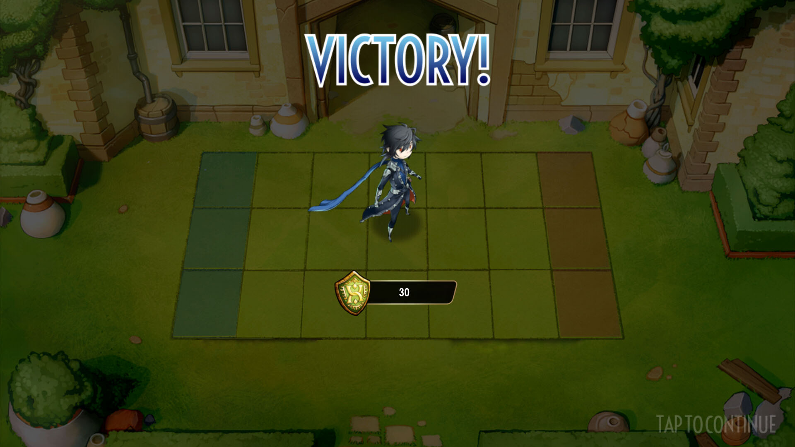
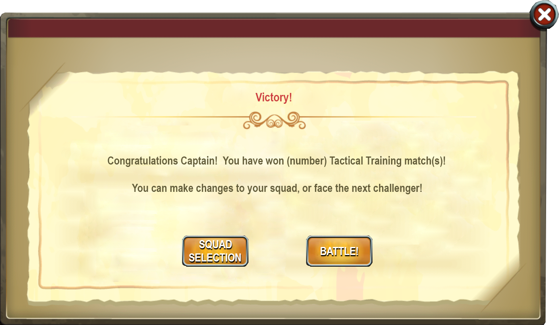

Slide 23
COMBAT FLOW
If a player wins 5 matches, a congratulatory dialogue window will appear with no further options. Closing the window will exit out of the feature and return the player to the main game screen.

Slide 24
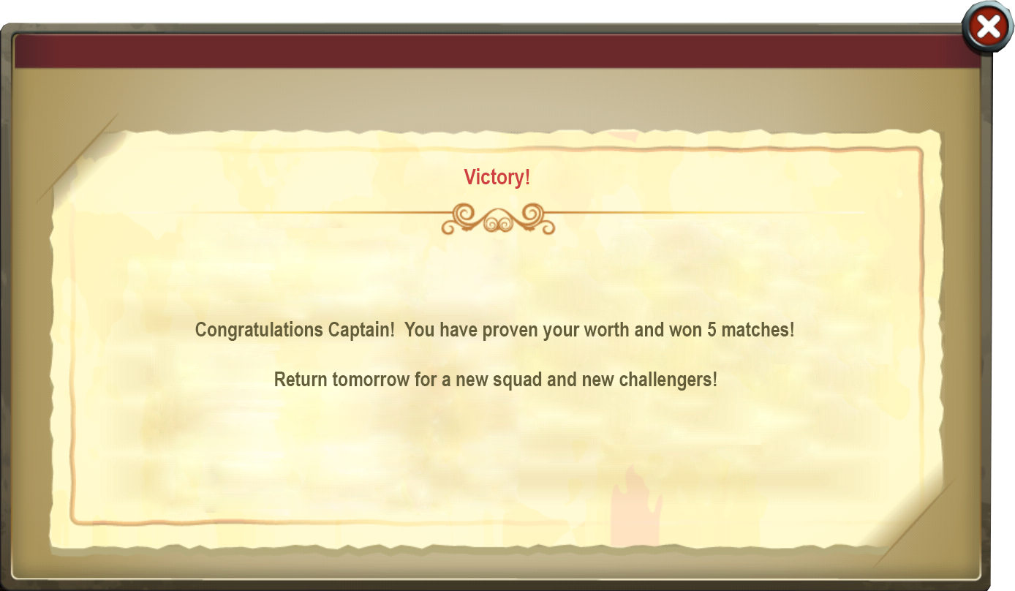

Slide 25
ACHIEVEMENT
If a player wins 5 matches in a row for the first time they will unlock an achievement:
Tactical Master – Win 5 matches in a row in Tactical Training
5000 XP

Slide 26
COMBAT FLOW
If a player is defeated a dialogue window with no further options will appear with a standard message. Closing the window will exit out of the feature and return the player to the main game screen.

Slide 27
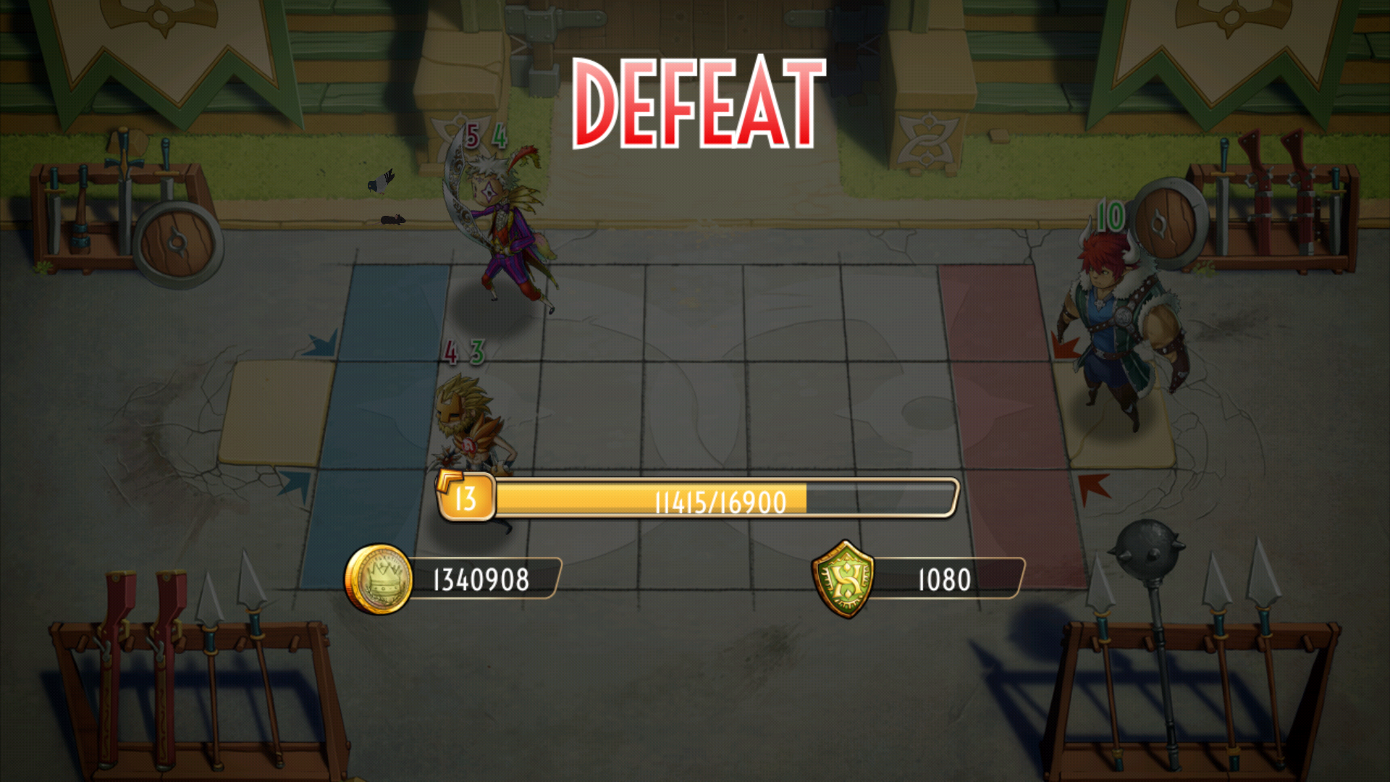
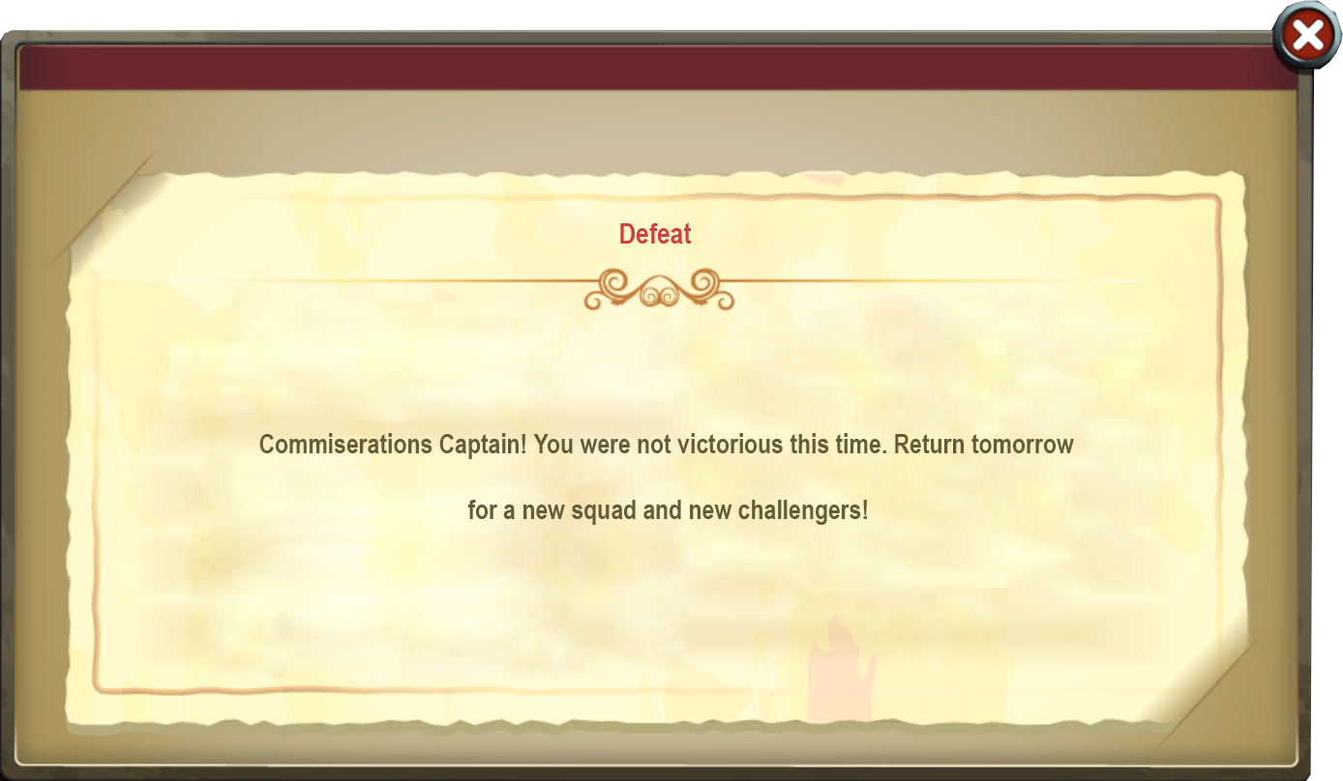

Slide 28
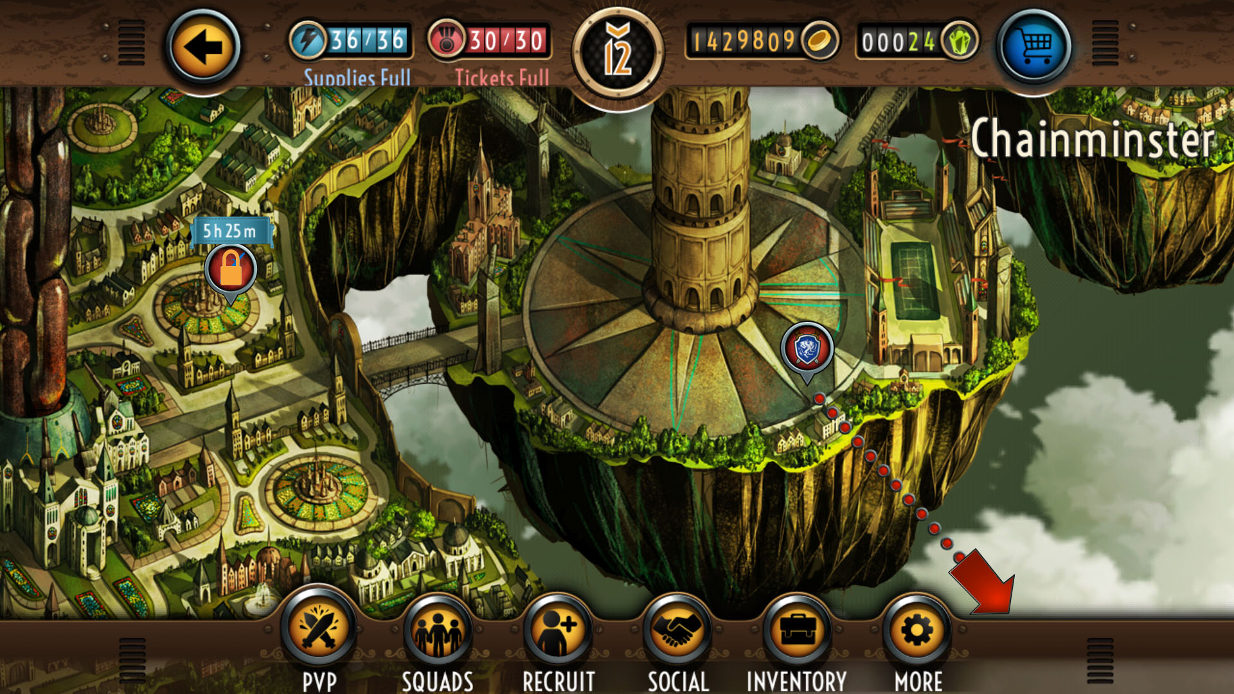
COMBAT FLOW
When the player has either won 5 matches or been defeated, the feature will appear locked to the player in the game menu, and will display the time remaining until the feature is available again.

Slide 29
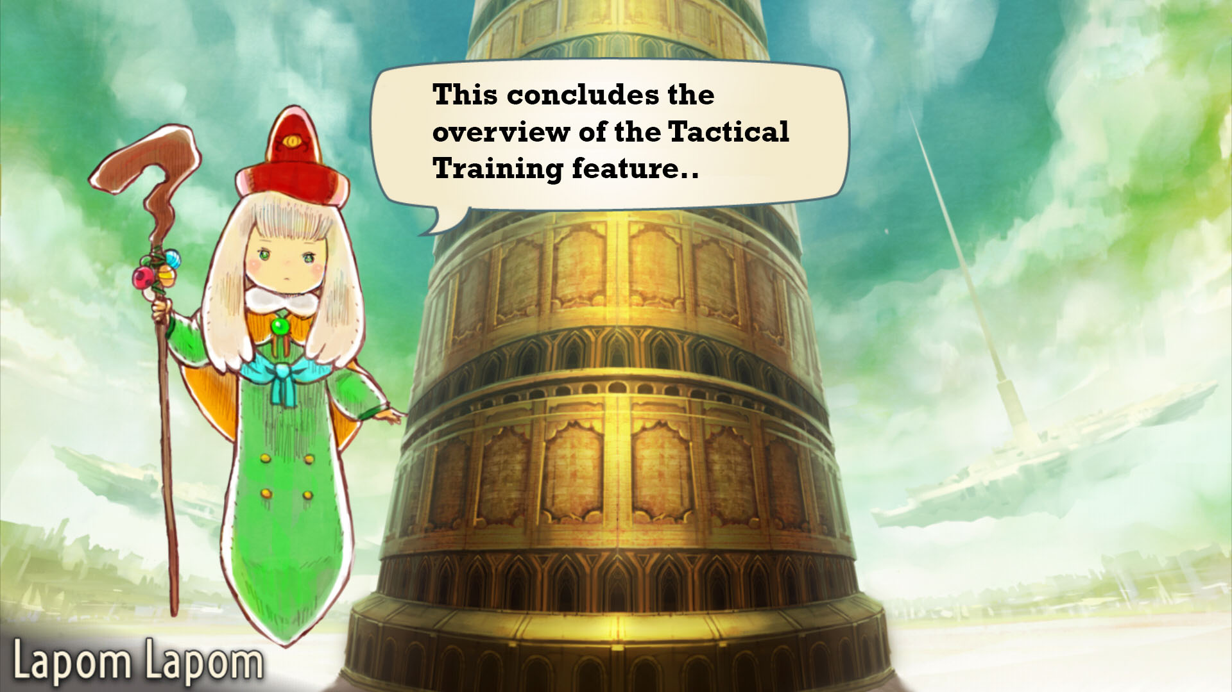
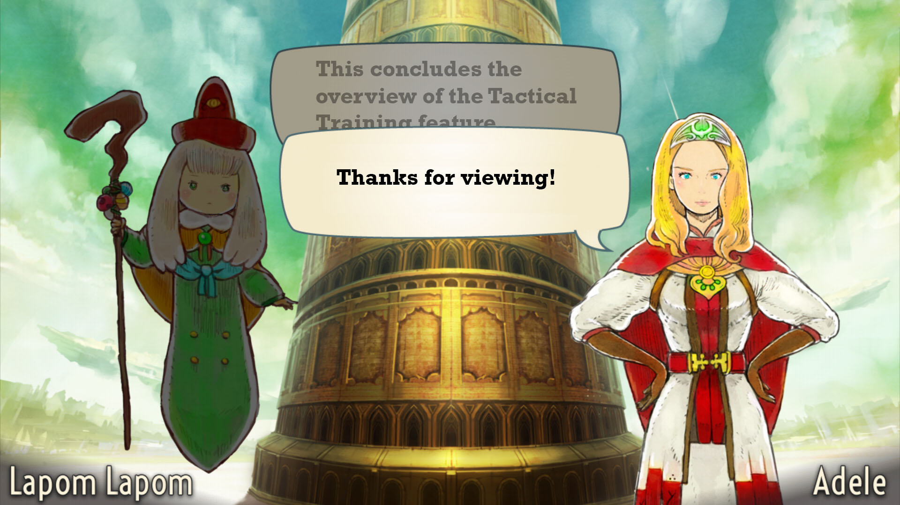

Slide 30
Daily Bonus Feature Design

